Slide 1
What does my condominium unit include?
And who has to maintain it?

Slide 2

The box in the sky

Slide 3
Horizontal boundaries
Definition examples:
Upper Boundary. The horizontal plane of the unfinished lower interior surface of the uppermost ceiling.
Lower Boundary. The horizontal plane of the unfinished upper interior surface of the floor.

Slide 4
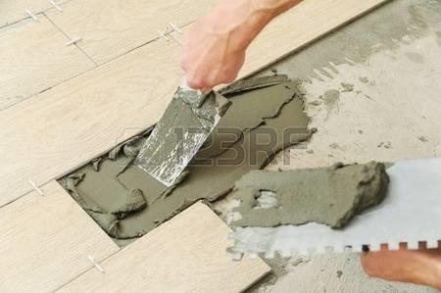
Floor

Slide 5
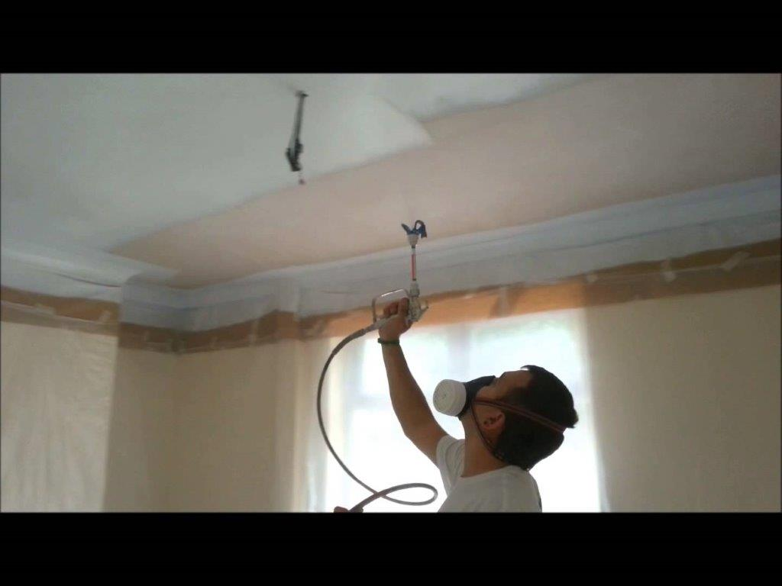
Ceiling

Slide 6
Vertical boundaries
Definition examples:
Vertical Boundaries (Planes). The vertical boundaries of each Unit shall be the vertical planes of the interior surfaces of exterior windows and glass doors bounding a Unit and the unfinished interior surfaces of the walls and entry doors bounding the Unit, excluding paint, wall paper, and light coverings, extended to their planer intersections with each other and with the upper and lower boundaries.

Slide 7
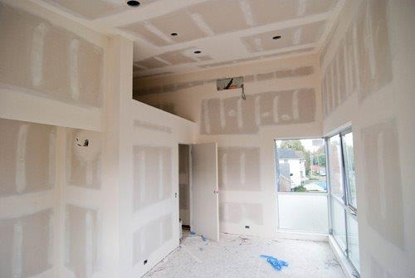
Walls

Slide 8
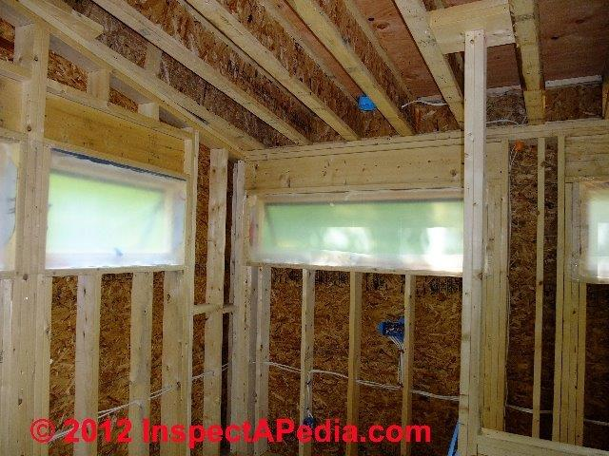
Stud Walls
Load bearing ?

Slide 9
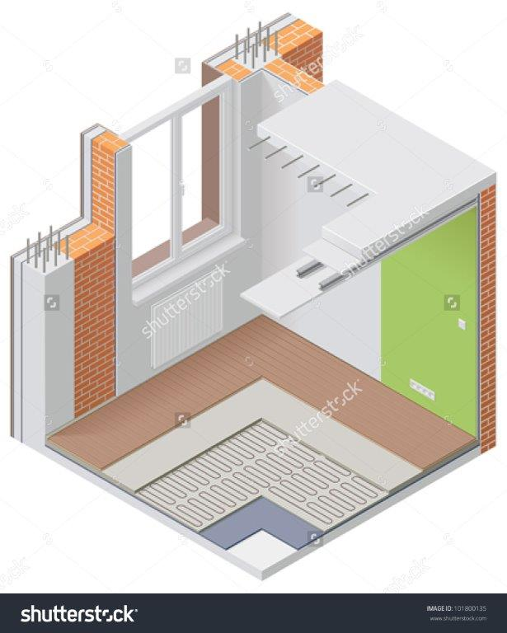
Windows

Slide 10
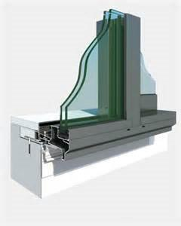

Slide 11
WHAT ARE THE COMMON ELEMENTS THAT BOUND AND SERVE MY UNIT
Exterior walls ✓
Windows ?
Plumbing ?
Wiring?

Slide 12
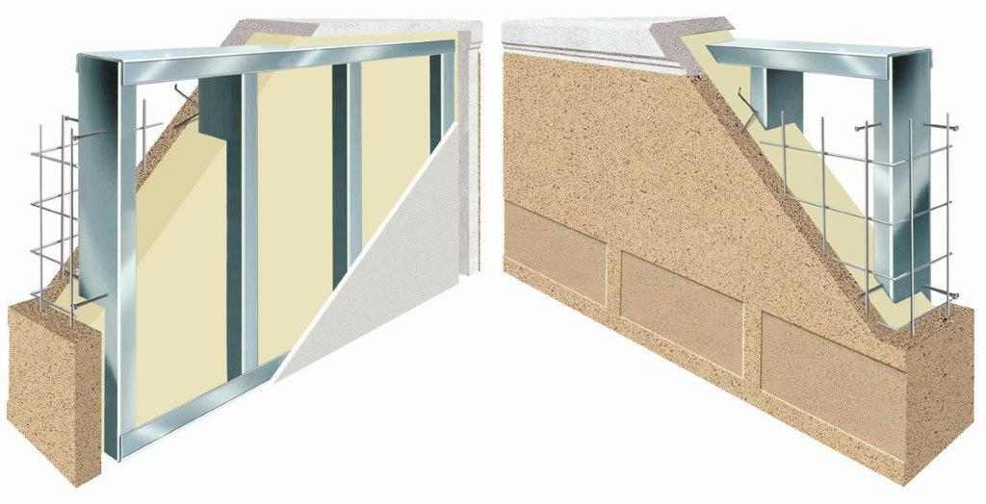

Slide 13
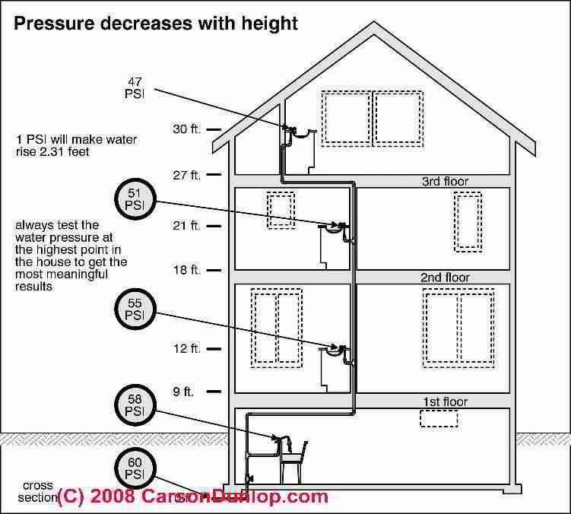
Plumbing/Wiring

Slide 14
Limited common elements
Example: Balconies

Slide 15
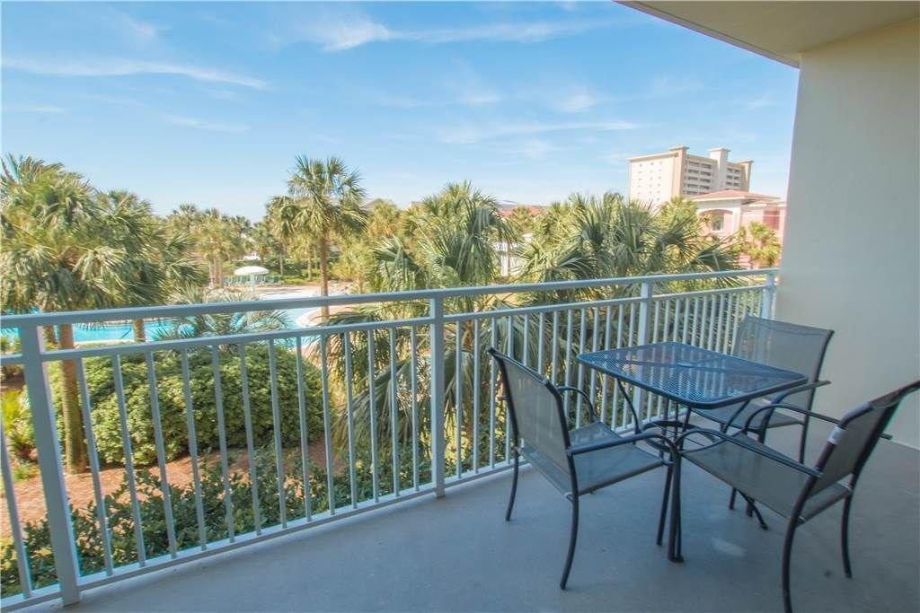

Slide 16
Who repairs limited common elements?
Example 1:
The patio, balcony, terrace or porch abutting each Condominium Residential Unit, including the storage closet or area, if any, located on said balcony, are Limited Common Elements appurtenant to those Units to which they attach and whose use is restricted to Units to which they are appurtenant. Doorsteps or stoops, if any, providing access to a patio, balcony, terrace or porch are assigned as a Limited Common Element to the Unit to which the patio, balcony, terrace or porch serves. The maintenance, repair, upkeep and replacement of each patio, balcony, terrace or porch, storage area and the doorsteps or stoops, if any, providing access thereto, shall be the exclusive responsibility of the Unit Owner to which that patio, balcony, terrace or porch and storage area shall be appurtenant.

Slide 17
Example 2:
Maintenance by the Association. The Association is responsible for maintenance, repair and replacement of the common elements and the limited common elements.

Slide 18
Who is responsible for repair and maintenance of the unit?
Me ?
The Condominium Association?
Insurance coverage?
What about the insurance deductible?

Slide 19


Slide 20
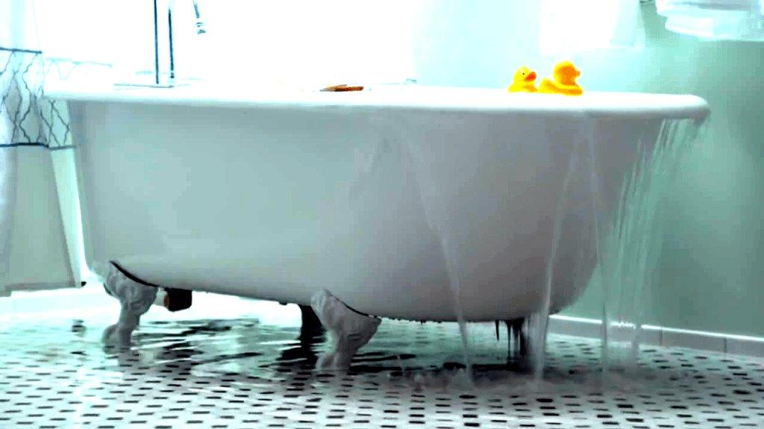

Slide 21
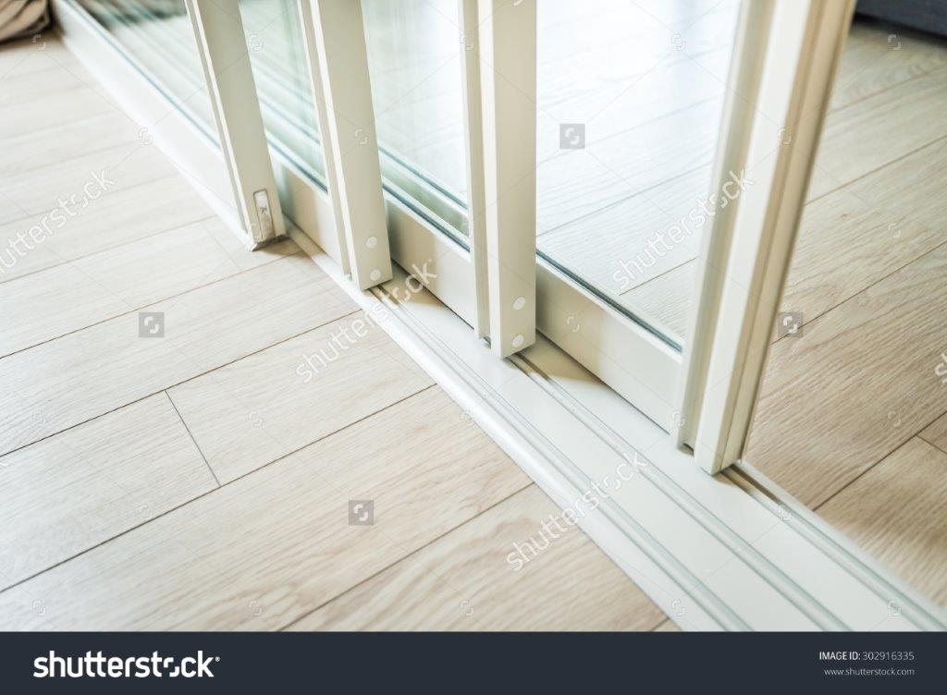
Window/Door Issues

Slide 22

Whose responsibility?

Slide 23
Generally in newer documents, windows and doors are common elements

Slide 24
In some older documents, like the following it is the unit owner’s responsibility
Each unit owner shall maintain his unit and the interior thereof in good tenantable condition and repair, and shall repair, maintain and replace if necessary the following:
    Windows, screening and glass, including glass between the unit and any patio or deck adjacent to such unit…
While the Condo Act requires all-in coverage in Section 35-8A-313 of the Act, it doesn’t change the unit owner responsibility for anything not covered by insurance. If there is insurance coverage available to address damage to things like windows and doors great, otherwise, it is the responsibility of the unit owner to take care of.

Slide 25
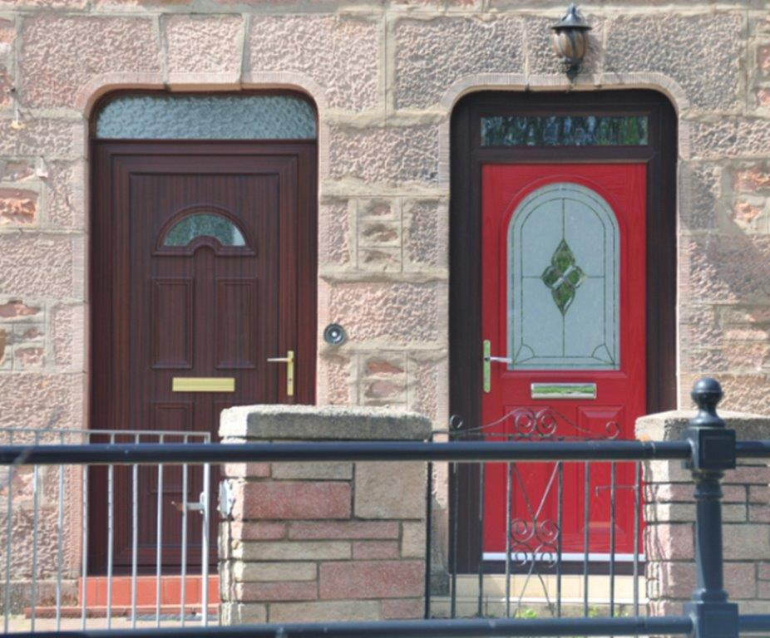

Slide 26
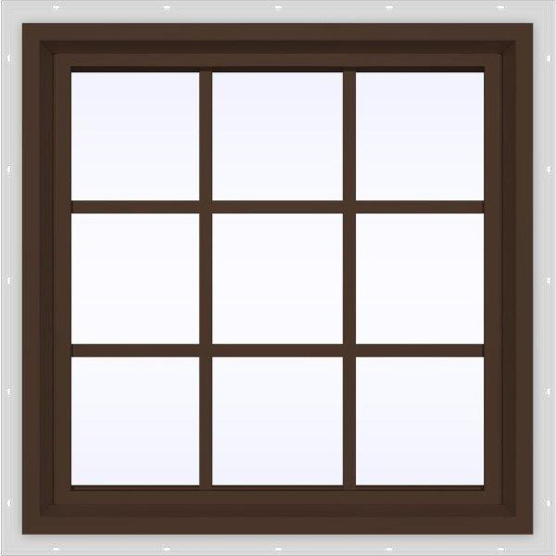

Slide 27
